Slide 1
Women in STEM at CT
10/07/2023

Slide 2
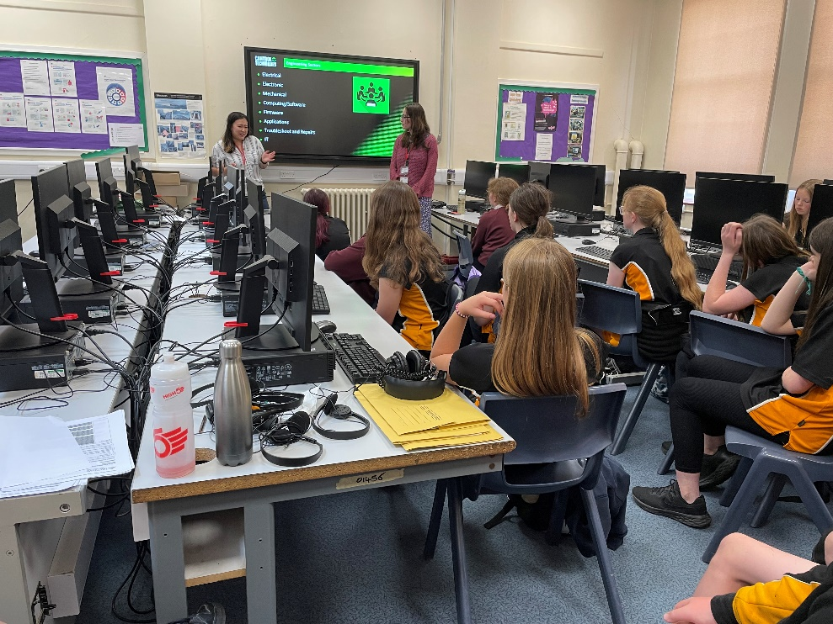

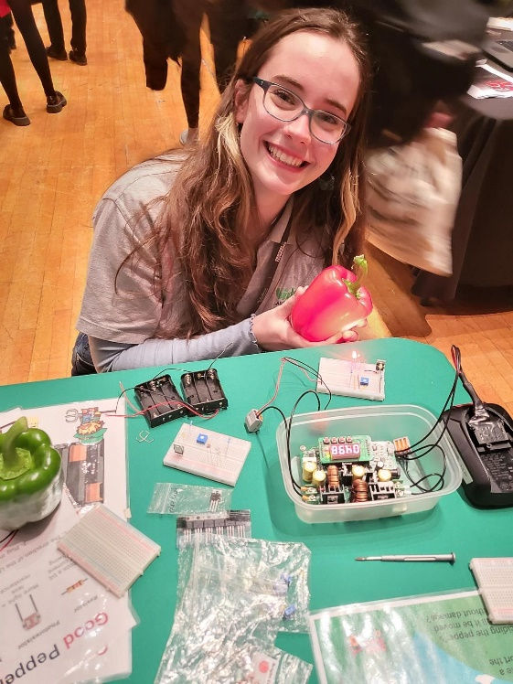
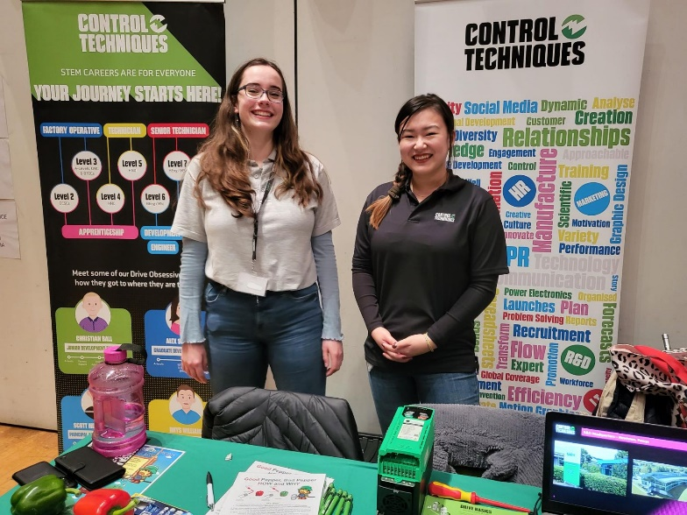

Previous Events
Careers Fair- Ceredigion Choose Your Future
Careers talk at Llanidloes High School
International Women’s Day Questions
Letter Writing
Apprentice Open Day

Slide 3



Future Events
Cyber First – Careers Wales
Fun cybersecurity demos with a local high school
STEM Careers (Shrewsbury) – STEM Ambassador
General careers talk about sciences in Shrewsbury area
https://www.stem.org.uk/platform/activity/8d3da8df-bf59-4fa9-9bcc-103e5bcbbfc3
The Access Project
Supporting disadvantaged young women (aged 14-18) through GCSE tutoring
https://www.theaccessproject.org.uk/

Slide 4
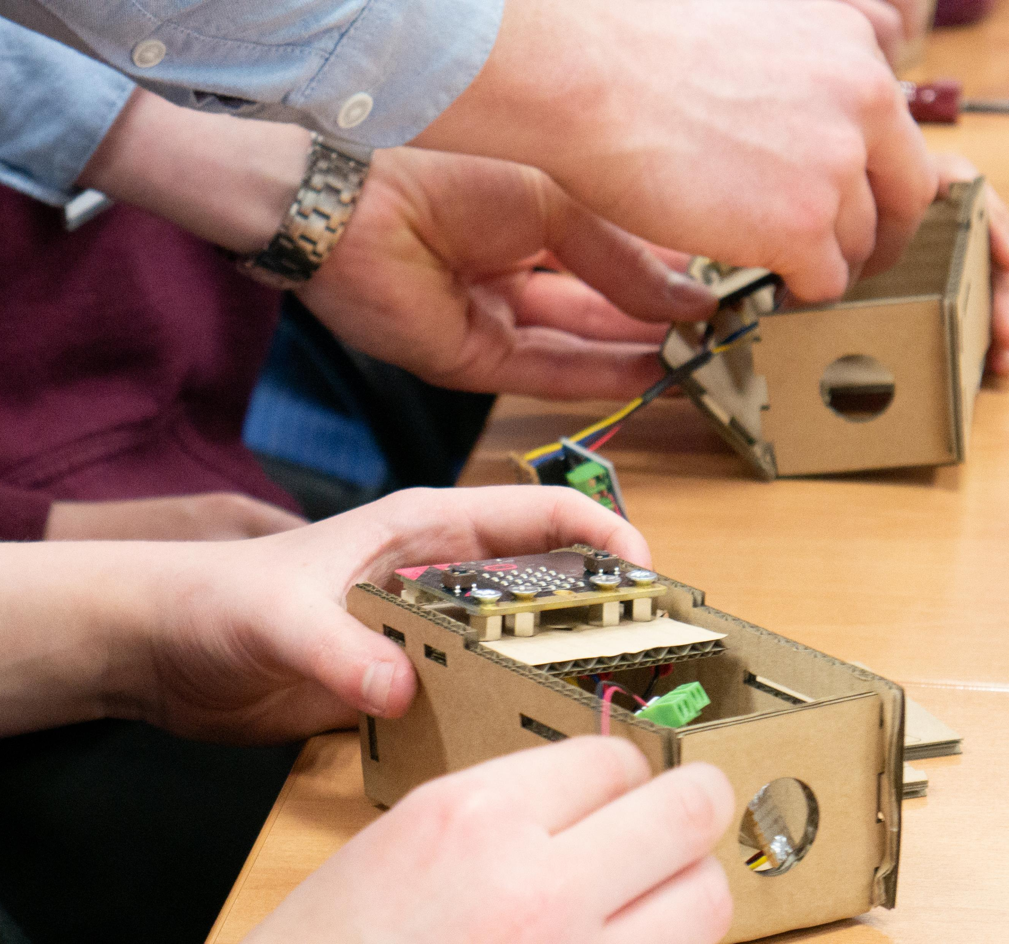
Other Ideas
Luke Orehawa’s MicroBit drives challenge
He has expressed interest in more activities
Make links with other high schools
Talk to Ben Partridge about local links

